Slide 1
Natural Language Processing (NLP)

Slide 2
Natural Language Processing (NLP)
Natural Language Processing (NLP) is a subfield of Artificial Intelligence (AI) and Linguistics that focuses on enabling computers to understand, interpret, and generate human language in a way that is both meaningful and useful.
Teaching computers to understand and work with human language.
Natural Language Processing is a field of computer science that deals with the interaction between computers and human (natural) languages, enabling machines to read, understand, and derive meaning from human language.”

Slide 3
Common uses of NLP
Text Classification
  Sentiment Analysis (Positive/Negative/Review)
  Spam detection
  Topic labeling
Machine Translation
Speech Recognition
  Voice assistants (Siri, Alexa, Google Assistant, etc)
Named Entity Recogition
  Identify entities like names, places, dates from text
Question Answering
  Chatbots, Search Engines

Slide 4
Common uses of NLP
Text Summarization
Part-of-Speech Tagging
  Identify verbs, nouns, adjectives, etc
Text Generation
  ChatGPT, etc
Language modeling
  Predict next word, auto-completion

Slide 5
Current applications of NLP
Chatbots and Virtual assistants
  Used in healthcare, banking, education (e.g., OpenAI ChatGPT, Google Bard, Microsoft Copilot)
Legal and Medical Document Analysis
  Automating contract reviews, legal translations, invoice generator, summarizing clinical notes
Sentiment Analysis in Finance and Marketing
  Understanding customer feedback, stock sentiment
AI Writing and Editing Tools
  Grammarly, Jasper, Copy.ai using NLP for grammar and tone correction

Slide 6
Current applications of NLP
Multilingual NLP
  Language translation with context (e.g., Meta’s SeamlessM4T model)
Voice-to-Text and Real-Time Transcription
  Zoom captions, YouTube auto subtitles, voice memos
Sentiment Analysis in Finance and Marketing
  Understanding customer feedback, stock sentiment
AI Writing and Editing Tools
  Grammarly, Jasper, Copy.ai using NLP for grammar and tone correction

Slide 7
Summary of Important concepts in NLP

Slide 8
Regular Expressions

Slide 9
Regular Expressions
Pattern Matching: Regular expressions (regex) are used to search and match specific patterns in text, such as email addresses, phone numbers, or hashtags.
Text Cleaning: Regex is essential in preprocessing text by removing unwanted characters like punctuation, HTML tags, or extra whitespace.
Tokenization: Regex helps break text into tokens (words, sentences, etc.) based on patterns like spaces or punctuation.
Normalization: Used to standardize text, such as converting all words to lowercase or finding and replacing specific substrings.
Information Extraction: Regex can extract structured data (like dates or names) from unstructured text, aiding in Named Entity Recognition (NER) and data mining tasks.

Slide 10
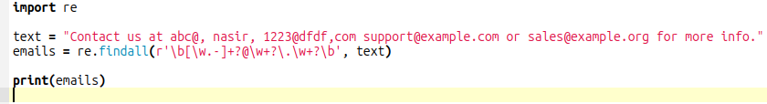

Regular Expressions - Example
Extracting Email address from text
This regex searches for email addresses using a pattern that matches word characters before and after the @ symbol and a valid domain suffix.
It's commonly used in NLP pipelines to extract contact information or filter out sensitive data.

Slide 11
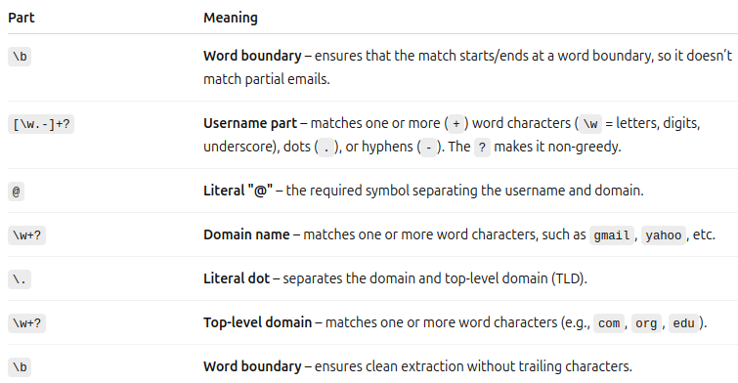
Regular Expressions - Example
Regular Expression
  \b[\w.-]+?@\w+?\.\w+?\b

Slide 12
N-gram Language Model

Slide 13
N-gram Language Models
An N-gram is a contiguous sequence of n items (usually words or characters) from a given text. An N-gram language model uses the occurrence of these sequences to predict the next word.
Types
  Unigram: Single word (n=1)
  Bigram: Two-word sequence (n=2)
  Trigram: Three word sequence (n=3)
  …
Goal
  Estimate the probability of a word given the previous (n-1) words
  P(wn​∣ wn−1​,wn−2​,...,w1​)

Slide 14
N-gram Language Models
Use cases of N-gram Language models
  Text prediction and auto completion
  Speech recognition
  Machine translation
  Spell correction
Not as powerful as neural models, but still useful for simple tasks

Slide 15
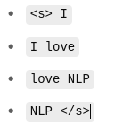
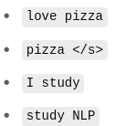
N-gram Language Models - Example
A bi-gram model predicts the probability of a word based on the previous word
Step-1 (Training Corpus) (Corpus is structured set of text for training)
  I love NLP
  I love pizza
  I study NLP
Step-2 (Tokenization)
  <s> I love NLP </s>
  <s> I love pizza </s>
  <s> I study NLP </s>
Step-3 (Extract Bigrams)

Slide 16
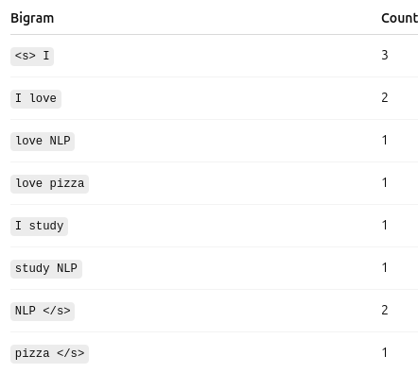
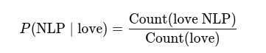

N-gram Language Models - Example
Step-4 (Count Bigrams)
Step-5 (Estimate Bigram Probability)
Total bigram starting with love (2)
Total bigram love NLP (1)
If a user types “I love”
  NLP has probability 0.5
  Pizza has probability 0.5

Slide 17
N-gram Language Models
Use cases of N-gram Language models
  Text prediction and auto completion
    I love pizza/NLP
  Speech recognition
    I saw a bear/bare in the woods"
  Machine translation
    “Il fait chaud” → “He is hot” / “It is hot”
  Spell correction
    I love to eat appl”

Slide 18
Naive Bayes and Semantic Classification

Slide 19

Naive Bayes and Semantic Classification
Naive Bayes is a probabilistic classifier based on Bayes’ Theorem.
It's called naive because it assumes feature independence — i.e., each word in a sentence contributes independently to the sentiment.
  Ignore word order
  Each word is assumed to act independently
  Simplifies computation
  Not always fast
Baye’s Theory
  C: Class (e.g. Positive, Negative)
  X: Feature (e.g. Words in sentences)
  P (C | X): Probability that text is class C based on X.

Slide 20
Vector Semantics

Slide 21
Vector Semantics
Vector Semanticsis a way to represent the meaning of words, phrases, or documents using mathematical vectors.
Why use Vectors?
  Because computers understand numbers not words
  Thus convert words to arrays of numbers
Basic concept
  Words that appear in similar contexts tend to have similar meanings.
  So we represent each word as a point in a high-dimensional space, where similar words are closer together.

Slide 22
Vector Semantics - Example
Convert words to 3D vectors (Just for illustration)
  Word, Vector
  King [0.8, 0.6, 0.7]
  Queen [0.79, 0.58, 0.75]
  Apple [0.2, 0.1, 0.3]
  Banana [0.21, 0.09, 0.29]
King and Queen are close
Apple and Banana are close
King and Apple are apart

Slide 23
Vector Semantics - Example
How are vectors created?
  Count based models
    Use word co-occuring count
    Term-Frequency,
  Prediction based models
    Word2Vec
    GloVe
    FastText
  Famous Word2Vec example
    king−man+woman≈queen

